Slide 1

Gokhale Education Society’s
R. H. Sapat College of Engineering, Management Studies and Research,
Nashik - 422 005, (M.S.), INDIA
Seminar on,
Securing Autonomous Vehicles From GPS spoofing attacks: Deep Learning Approach
In partial fulfillment of requirements for the degree
Third Year Computer Engineering
By
SHUKLA ADVAIT UPENDRA
Roll No. : 49
Under the guidance of
Mrs.V.S. Nikam
GESCOE, Department of Computer
‹#›

Slide 2
Index
Introduction to the Topic
Literature Review
Details Of Technology
Necessity
Algorithms
Conclusion
References
GESCOE, Department of Computer
‹#›

Slide 3
Introduction
1. Autopilot systems like autonomous vehicles rely on GPS and high-definition maps, necessitating reliable GPS signals for autonomous operation.
2. Communication between autonomous vehicles and ground stations is vulnerable to cyber-attacks like jamming and spoofing, which can disrupt or deceive GPS signals.
3. Robust architecture is crucial to withstand Denial of Service (DoS) and integrity attacks on autonomous vehicles.
4. GNSS spoofing poses significant risks, highlighting the need for specialized receivers capable of countering advanced attacks.
5. Machine and deep learning techniques are employed for interference detection and data quality assurance in GNSS, enhancing the accuracy and reliability of GPS spoofing detection.
GESCOE, Department of Computer
‹#›

Slide 4
Literature Review
Author | Title | Year
MALIHA SHABBIR , MOHSIN KAMAL, ZAHID ULLAH, MAQSOOD MUHAMMAD KHAN | Securing Autonomous Vehicles Against GPS Spoofing Attacks: A Deep Learning Approach | 2023
GESCOE, Department of Computer
‹#›

Slide 5
Details of Technology
GESCOE, Department of Computer
‹#›

Slide 6
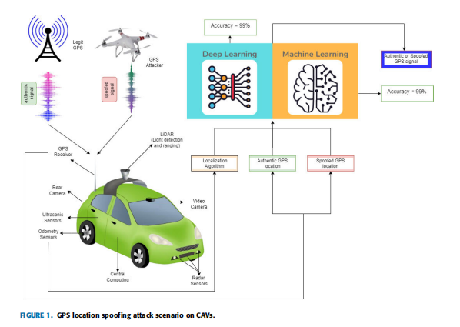
GESCOE, Department of Computer
‹#›

Slide 7
Firstly, What are autonomous Vehicle?
1. Autonomous vehicles, or self-driving cars, operate without human input using sensors, cameras, and AI for navigation and decision-making.
2. Their significance lies in their potential to reduce accidents, enhance efficiency, and provide mobility solutions for those unable to drive, such as the elderly or disabled.
3. Examples of autonomous vehicles include Tesla's Autopilot, Waymo's self-driving cars, and Uber's self-driving trucks.
4. Autonomous vehicles have the potential to alleviate traffic congestion and improve transportation infrastructure.
5. They represent a transformative technology with wide-ranging implications for safety, transportation, and accessibility.
GESCOE, Department of Computer
‹#›

Slide 8
What is GPS Spoofing?
1. GPS spoofing is a cyber attack that involves sending fake GPS signals to manipulate a receiver's perception of location.
2. Autonomous vehicles heavily depend on GPS signals for navigation, rendering them susceptible to GPS spoofing attacks.
3. Consequences of GPS spoofing attacks on autonomous vehicles can be severe, including accidents, loss of life, and property damage.
4. A notable example of GPS spoofing's danger is the 2013 incident where researchers took control of a drone by hacking its GPS system.
5. Ensuring robust cybersecurity measures and redundancies in navigation systems is crucial to mitigate the risks posed by GPS spoofing in autonomous vehicles.
GESCOE, Department of Computer
‹#›

Slide 9
Necessity
1.Sophisticated Threat Detection 2.Adaptability to Evolving Attacks 3.Real-time Response
4.Reducing Reliance on Prior Knowledge
5.Enhancing Overall System Security
GESCOE, Department of Computer
GESCOE, Department of Computer
‹#›
‹#›

Slide 10
Algorithms
Machine Learning Algorithms -Support Vector Machine (SVM)
Deep Learning Algorithms -Convolutional Neural Networks (CNN)
- Long Short-Term Memory (LSTM)
- Deep Neural Networks (DNN)
GESCOE, Department of Computer
GESCOE, Department of Computer
‹#›
‹#›

Slide 11
How deep learning can help solve this issue?
1. Deep learning enhances autonomous vehicle security by detecting complex patterns in data, including GPS spoofing attacks that mimic legitimate signals.
2. Its adaptability allows for quick responses to evolving threats, ensuring ongoing safety as attack methods change.
3. Real-time data processing capabilities make deep learning essential for autonomous vehicle cybersecurity.
4. Deep learning's rapid data analysis and response contribute to vehicle safety.
5. Integrating deep learning into security measures is crucial to safeguard autonomous vehicles against evolving threats like GPS spoofing.
GESCOE, Department of Computer
‹#›

Slide 12

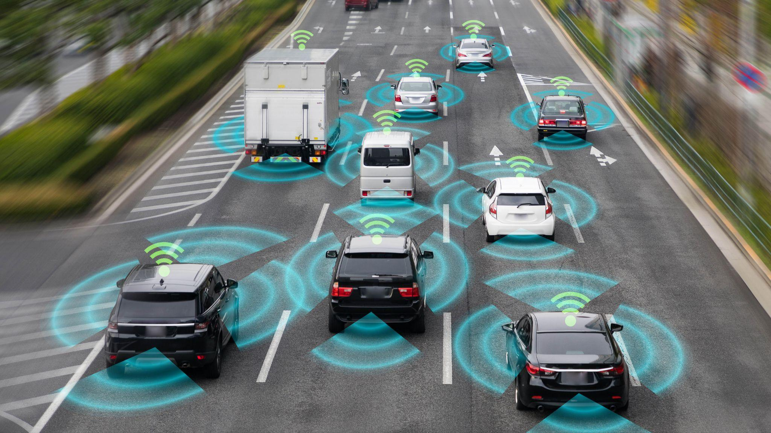
Let’s have a safer future: Thanks to Deep Learning Algorithms
GESCOE, Department of Computer
‹#›

Slide 13
Understanding the Algorithms
1. Deep learning algorithms are a promising solution for securing autonomous vehicles against GPS spoofing attacks by analyzing GPS signals and detecting anomalies.
2. Various deep learning algorithms, such as Convolutional Neural Networks (CNNs) and Support Vector Machines (SVMs), can be employed for this purpose.
3. CNNs excel in recognizing spatial patterns in data, making them suitable for analyzing GPS signals.
4. SVMs are adept at identifying anomalies in data, aiding in the detection of GPS spoofing attacks.
5. Leveraging these deep learning algorithms can enhance the security of autonomous vehicles by actively identifying and preventing GPS spoofing threats.
GESCOE, Department of Computer
‹#›

Slide 14
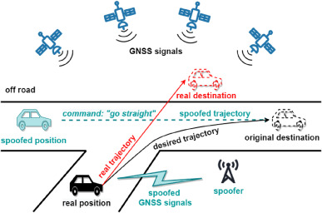

GPS Location Spoofing Attack Detection using CNN
GESCOE, Department of Computer
‹#›

Slide 15
GPS Location Spoofing Attack Detection using CNN
1. CNNs are a potent tool for identifying GPS spoofing attacks in autonomous vehicles, having been trained on extensive datasets of authentic and spoofed GPS signals to learn distinctive features.
2. These deep learning algorithms excel at automatically extracting crucial information from raw GPS data, eliminating the need for manual feature engineering and enhancing adaptability across various GPS spoofing scenarios.
3. CNNs offer the flexibility to detect multiple types of GPS spoofing attacks concurrently, making them versatile and comprehensive safeguards for autonomous vehicles.
4. By utilizing CNNs, autonomous vehicles can accurately identify the presence of GPS signal spoofing and respond accordingly to maintain safety and integrity.
5. The use of CNNs in GPS spoofing detection underscores their significance in enhancing the security and reliability of autonomous vehicle navigation systems.
GESCOE, Department of Computer
‹#›

Slide 16
CNN ALGORITHM
1. **Input Data**: The algorithm starts with GPS signal data as input, which is represented as a grid-like structure suitable for processing by a Convolutional Neural Network (CNN).
2. **Feature Extraction**: Convolutional layers apply filters to identify important spatial patterns within the data. These filters learn specific features, such as characteristic patterns associated with GPS spoofing attacks.
3. **Downsampling and Non-linearity**: Pooling layers downsample the data, reducing computational complexity. Activation functions like ReLU introduce non-linearity, enabling the network to learn complex relationships.
GESCOE, Department of Computer
‹#›

Slide 17
CNN ALGORITHM
4. **Fully Connected Layers**: These layers aggregate high-level features learned by the CNN, providing the final classification output indicating whether the input represents a spoofed GPS signal.
5. **Training and Evaluation**: The model is trained on a labeled dataset, adjusting its internal parameters to minimize the loss function. After training, it is tested on a separate dataset to assess its performance using metrics like accuracy and precision.
GESCOE, Department of Computer
‹#›

Slide 18
What future looks like and conclusions that can be drawn
1. Securing autonomous vehicles from GPS spoofing attacks is a pressing concern due to the potential for severe consequences.
2. Deep learning algorithms like CNN and SVM offer a promising solution for detecting and preventing GPS spoofing attacks by leveraging their capabilities in recognizing anomalies in sensor data.
3. These algorithms have already demonstrated success in detecting GPS spoofing attacks, with the potential for further refinement through ongoing research and development efforts.
4. Investment in the continued development and implementation of these algorithms is crucial to ensure the safety and security of autonomous vehicles and their passengers.
5. By addressing GPS spoofing vulnerabilities, we can work towards a future where autonomous vehicles become a commonplace and safe mode of transportation on our roads.
GESCOE, Department of Computer
‹#›

Slide 19
References
[1]Securing Autonomous Vehicles Against GPS Spoofing Attacks: A Deep Learning Approach
Maliha Shabbir;Mohsin Kamal;Zahid Ullah;Maqsood Muhammad Khan IEEE AccessYear: 2023 | Volume: 11 | Journal Article | Publisher: IEEE
[2] S. Filippou, A. Achilleos, S. Z. Zukhraf, C. Laoudias, K. Malialis,
M. K. Michael, and G. Ellinas, ‘‘A machine learning approach for detecting
GPS location spoofing attacks in autonomous vehicles,’’ in Proc. IEEE
97th Veh. Technol. Conf., Jun. 2023, pp. 1–7.
[3] M. Kamal, A. Barua, C. Vitale, C. Laoudias, and G. Ellinas, ‘‘GPS location
spoofing attack detection for enhancing the security of autonomous
vehicles,’’ in Proc. IEEE 94th Veh. Technol. Conf., Sep. 2021, pp. 1–7.
[4] A. Shafique, A. Mehmood, and M. Elhadef, ‘‘Detecting signal spoofing
attack in UAVs using machine learning models,’’ IEEE Access, vol. 9,
pp. 93803–93815, 2021.
[5] K. Ren, Q. Wang, C. Wang, Z. Qin, and X. Lin, ‘‘The security of
autonomous driving: Threats, defenses, and future directions,’’ Proc. IEEE,
vol. 108, no. 2, pp. 357–372, Feb. 2020.
GESCOE, Department of Computer
‹#›

Slide 20
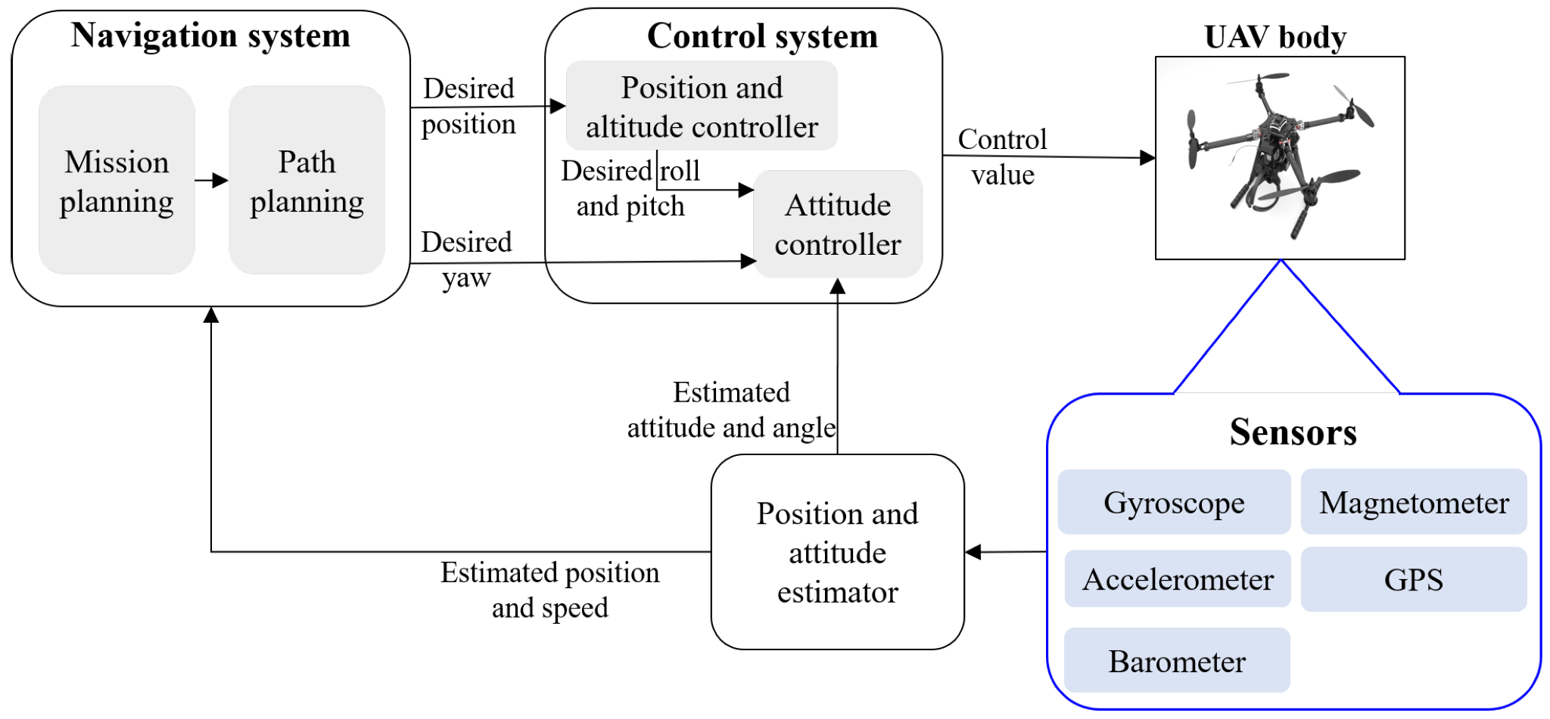
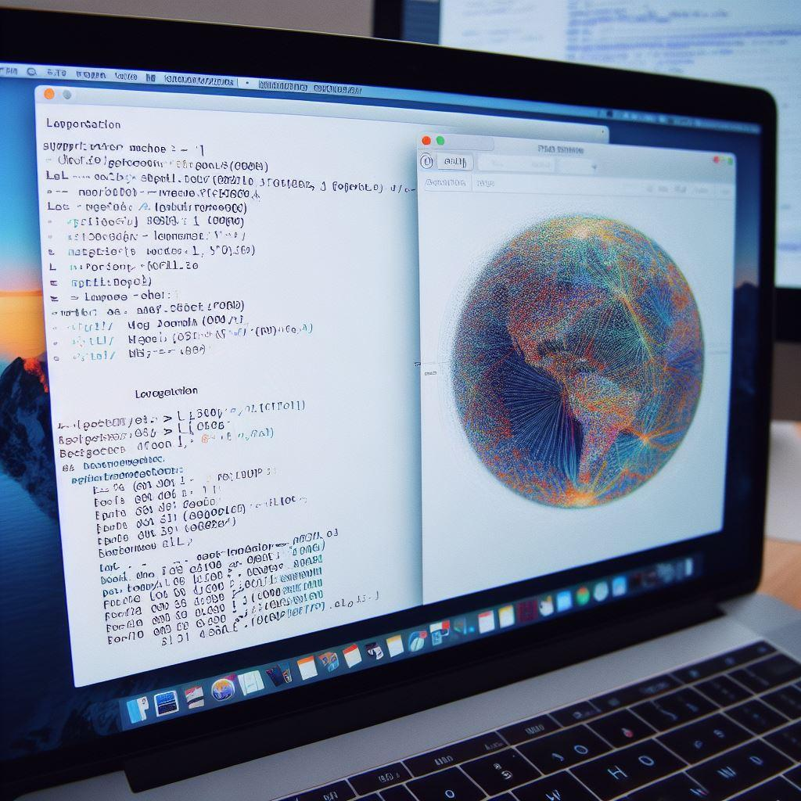
GPS Location Spoofing Attack Detection using SVM
GESCOE, Department of Computer
‹#›

Slide 21
GPS Location Spoofing Attack Detection using SVM
1. Support Vector Machine (SVM) is a potent deep learning algorithm for pinpointing GPS location spoofing attacks in autonomous vehicles by analyzing sensor data and comparing it to expected vehicle behavior.
2. SVM boasts high accuracy in handling large datasets, making it well-suited for the data-intensive environment of autonomous vehicles where massive data volumes are generated continuously.
3. SVM's versatility shines as it can be trained effectively using both labeled and unlabeled data, further enhancing its precision in detecting GPS spoofing attacks.
4. The robust capabilities of SVM enable it to identify anomalies in sensor data, providing a reliable defense mechanism against GPS spoofing threats to ensure vehicle safety.
5. Utilizing SVM as a security measure underscores its importance in fortifying the integrity and dependability of autonomous vehicle systems against potential GPS spoofing attacks.
GESCOE, Department of Computer
‹#›

